Slide 1
CS 371 Artificial Intelligence
Samyan Qayyum Wahla
Fall 2023
Course Credits: Stanford-CS221

Slide 2


Slide 3
Project Announcements
Completed So Far
Project Groups
Proposal Submission
Understanding of Relevant Algorithms
Poster
Run at least one algorithm from relevant algorithms
demonstrate code and results Use existing Github Repositories
Whats Next?
Write a report for the work done so far, with proper results explanation

Slide 4
Quiz Announcement
Quiz 2
November 23, 2023
Project Poster with Progress Report
In Lab
Starting from Week November 27

Slide 5
Question
Find two neighboring countries, one that begins with an A and the other that speaks Hungarian.

Slide 6
Course Plan
Search problems
Markov decision processes
Adversarial games
Constraint satisfaction problems
Bayesian networks
Reflex
States
Variables
Logic
Low Level Intelligence
High Level Intelligence
Artificial Intelligence

Slide 7
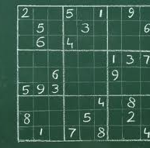
Constrain Satisfaction Problem

Slide 8
Reading Material for this Week
Chapter 5: Constraints Satisfaction Problem
from
Artificial Intelligence: A Modern Approach

Slide 9
Paradigm
Major Pillars
Modeling
Learning
Inference

Slide 10
State-based models
[Modeling]
Framework
search problems
MDPs/games
Objective
minimum cost paths
maximum value policies
[Inference]
Tree-based backtracking
Graph-based DP, UCS, A*
minimax/expectimax
value/policy iteration
[Learning]
Methods
structured Perceptron Q-learning, TD learning
Notes:
Modeling: In the context of state-based models, we seek to find minimum cost paths (for search problems) or maximum value policies (for MDPs and games).
Inference: To compute these solutions, we can either work on the search/game tree or on the state graph. In the former case, we end up with recursive procedures which take exponential time but require very little memory (generally linear in the size of the solution). In the latter case, where we are fortunate to have few enough states to fit into memory, we can work directly on the graph, which can often yield an exponential savings in time.
Given that we can find the optimal solution with respect to a fixed model, the final question is where this model actually comes from. Learning provides the answer: from data. You should think of machine learning as not just a way to do binary classification, but more as a way of life, which can be used to support a variety of different models.
In the rest of the course, modeling, inference, and learning will continue to be the three pillars of all
techniques we will develop.

Slide 11

State-based models: takeaway 1
B
S
G
A
Key idea: specify locally, optimize globally
Modeling: specifies local interactions Inference: find globally optimal solutions
Notes:
One high-level takeaway is the motto: specify locally, optimize globally. When we’re building a search problem, we only need to specify how the states are connected through actions and what the local action costs are; we need not specify the long-term consequences of taking an action. It is the job of the inference to take all of this local information into account and produce globally optimal solutions (minimum cost paths).
This separation is quite powerful in light of modeling and inference: having to worry only about local interactions makes modeling easier, but we still get the benefits of a globally optimal solution via inference which are constructed independent of the domain-specific details.
We will see this local specification + global optimization pattern again in the context of variable-based models.

Slide 12
State-based models: takeaway 2
B
S
G
A
Key idea: state
A state is a summary of all the past actions sufficient to choose future actions optimally.
Mindset: move through states (nodes) via actions (edges)
Notes:
The second high-level takeaway which is core to state-based models is the notion of state. The state, which summarizes previous actions, is one of the key tools that allows us to manage the exponential search problems frequently encountered in AI. We will see the notion of state appear again in the context of conditional independence in variable-based models.
With states, we were in the mindset of thinking about taking a sequence of actions (where order is important) to reach a goal. However, in some tasks, order is irrelevant. In these cases, maybe search isn’t the best way to model the task. Let’s see an example.

Slide 13
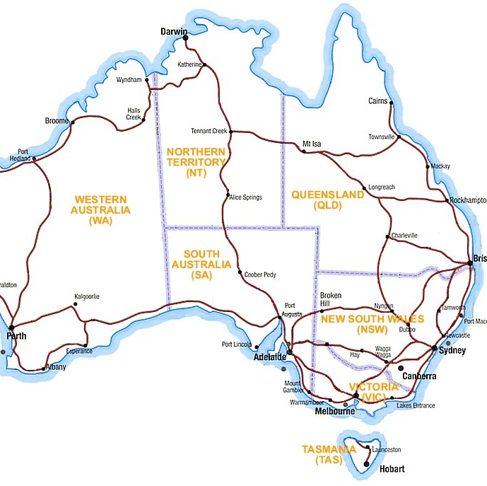
Question: how can we color each of the 7 provinces {red,green,blue} so that no two neighboring provinces have the same color?

Slide 14
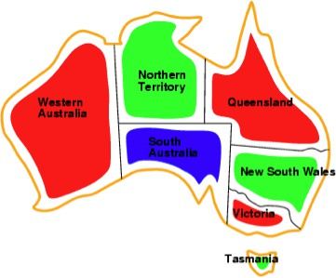
Map coloring
(one possible solution)

Slide 15
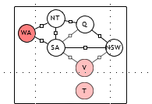
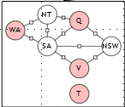
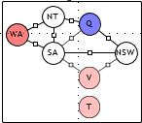
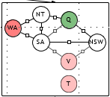
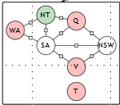
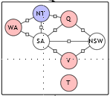
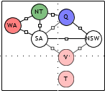
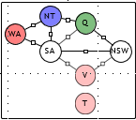
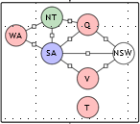
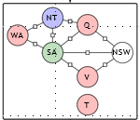
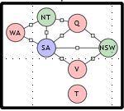
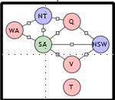
Search

Slide 16
As a search problem
NT
Q
WA
SA
NSW
State: partial assignment of colors to provinces
Action: assign next uncolored province a compatible color
What’s missing?
There’s more problem structure!
Variable ordering doesn’t affect correctness
Variables are interdependent in a local way
V
T
Notes:
We can certainly use search to find an assignment of colors to the provinces of Australia. Let’s fix an arbitrary ordering of the provinces. Each state contains an assignment of colors to a subset of the provinces (a partial assignment), and each action chooses a color for the next unassigned province as long as the color isn’t already assigned to one of its neighbors. In this way, all the leaves of the search tree are solutions (18 of them). (In the slide, in the interest of space, we’ve only shown the subtree rooted at a partial assignment to 3 variables.)
This is a fine way to solve this problem, and in general, it shows how powerful search is: we don’t actually need any new machinery to solve this problem. But the question is: can we do better?
First, the particular search tree that we drew had several dead ends; it would be better if we could detect these earlier. We will see in this lecture that the fact that the order in which we assign variables doesn’t matter for correctness gives us the flexibility to dynamically choose a better ordering of the variables. That, with a bit of lookahead will allow us to dramatically improve the efficiency over naive tree search.
Second, it’s clear that Tasmania’s color can be any of the three colors regardless of the colors on the
mainland. This is an instance of independence, and next time, we’ll see how to exploit these observations systematically.

Slide 17

Variable-based models
A new framework...
Key idea:variables
Solutions to problems ⇒ assignments to variables (modeling).
Decisions about variable ordering, etc. chosen by inference.
Notes:
With that motivation in mind, we now embark on our journey into variable-based models. Variable- based models is an umbrella term that includes constraint satisfaction problems (CSPs), Markov networks, Bayesian networks, hidden Markov models (HMMs), conditional random fields (CRFs), etc., which we’ll get to later in the course. The term graphical models can be used interchangeably with variable-based models, and the term probabilistic graphical models (PGMs) generally encompasses both Markov networks (also called undirected graphical models) and Bayesian networks (directed graphical models).
The unifying theme is the idea of thinking about solutions to problems as assignments of values to variables (this is the modeling part). All the details about how to find the assignment (in particular, which variables to try first) are delegated to inference. So the advantage of using variable-based models over state-based models is that it’s making the algorithms do more of the work, freeing up more time for modeling.
An apt analogy is programming languages. Solving a problem directly by implementing an ad-hoc program is like using assembly language. Solving a problem using state-based models is like using C. Solving a problem using variable-based models is like using Python. By moving to a higher language, you might forgo some amount of ability to optimize manually, but the advantage is that (i) you can think at a higher level and (ii) there are more opportunities for optimizing automatically.
Once the different modeling frameworks become second nature, it is almost as if they are invisible. It’s like when you master a language, you can ”think” in it without constantly referring to the framework.

Slide 18
Roadmap
Factor graphs
Arc consistency
Modeling
Dynamic ordering

Slide 19

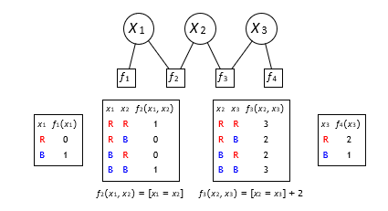
Factor graph (example)
B or R?
must agree
B or R?
tend to agree
B or R?
Notes:
The most important concept for the next three weeks will be that of a factor graph. But before we define it formally, let us consider a simple example.
Suppose there are three people, each of which will vote for a color, red or blue. We know that Person 1 is leaning pretty set on blue, and Person 3 is leaning red. Person 1 and Person 2 must have the same color, while Person 2 and Person 3 would weakly prefer to have the same color.
We can model this as a factor graph consisting of three variables, X₁, X₂, X₃, each of which must be
assigned red (R) or blue (B).
We encode each of the constraints/preferences as a factor, which assigns a non-negative number based on the assignment to a subset of the variables. We can either describe the factor as an explicit table, or via a function (e.g., [x₁ = x₂]).

Slide 20

Factor graph
X₁ X₂ X₃
f₁
f₂
f₃
f₄
Definition: factor graph
Variables:
X = (X₁, . . . , X_{n}), where X_{i} ∈ Domain_{i} Factors:
f₁, . . . , f_{m}, with each f_{j} (X) ≥ 0
Notes:
Now we proceed to the general definition. a factor graph consists of a set of variables and a set of factors:
(i) n variables X₁, . . . , X_{n}, which are represented as circular nodes in the graphical notation; and (ii) m factors (also known as potentials) f₁, . . . , f_{m}, which are represented as square nodes in the graphical notation.
Each variable X_{i} can take on values in its domain Domain_{i}. Each factor f_{j} is a function that takes an
assignment x to all the variables and returns a non-negative number representing how good that assignment is (from the factor’s point of view). Usually, each factor will depend only on a small subset of the variables.

Slide 21
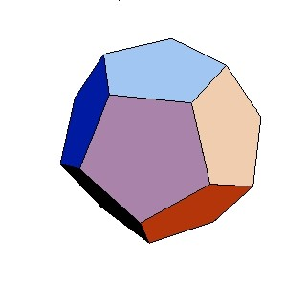
Example: map coloring
NT
Q
WA
SA
NSW
V
T
Variables:
X = (WA, NT, SA, Q, NSW, V, T)
Domain_{i} ∈ {R, G, B}
Factors:
f₁(X) = [WA /= NT]
f₂(X) = [NT /= Q]
...
Notes:
Notation: we use [condition] to represent the indicator function which is equal to 1 if the condition is true and 0 if not. Normally, this is written 1[condition], but we drop the 1 for succinctness.

Slide 22
Factors
Definition: scope and arity
Scope of a factor f_{j} : set of variables it depends on.
Arity of f_{j} is the number of variables in the scope.
Unary factors (arity 1); Binary factors (arity 2).
Example: map coloring
Scope of f₁(X) = [WA /= NT] is {WA, NT}
f₁ is a binary factor
Notes:
The key aspect that makes factor graphs useful is that each factor f_{j} only depends on a subset of variables, called the scope. The arity of the factors is generally small (think 1 or 2).

Slide 23
Assignment weights (example)
x₃ f₄(x₃)
R 2
B 1
x₂ x₃ f₃(x₂, x₃)
R R 3
R B 2
B R 2
B B 3
x₁ x₂ x₃ Weight
R R R 0 · 1 · 3 · 2 = 0 R R B 0 · 1 · 2 · 1 = 0 R B R 0 · 0 · 2 · 2 = 0 R B B 0 · 0 · 3 · 1 = 0 B R R 1 · 0 · 3 · 2 = 0 B R B 1 · 0 · 2 · 1 = 0 B B R 1 · 1 · 2 · 2 = 4 B B B 1 · 1 · 3 · 1 = 3
x₁ x₂ f₂(x₁, x₂)
R R 1
R B 0
B R 0
B B 1
x₁ f₁(x₁)
R 0
B 1

Slide 24
Definition: assignment weight
Each assignment x = (x₁, . . . , x_{n}) has a weight:
Y
j=1
m
Weight(x) =
f (x)
j
Objective: find the maximum weight assignment
arg max Weight(x)
x

Slide 25
Example: map coloring
NT
Q
WA
SA
NSW
V
T
Assignment:
x = {WA : R, NT : G, SA : B, Q : R, NSW : G, V : R, T : G}
Weight:
Weight(x) =
Assignment:
x′ = {WA : R, NT : R, SA : B, Q : R, NSW : G, V : R, T : G}
Weight:
Weight(x′) =
Notes:
In the map coloring example, each factor only looks at the variables of two adjacent provinces and checks if the colors are different (returning 1) or the same (returning 0). From a modeling perspective, this allows us to specify local interactions in a modular way. A global notion of consistency is achieved by multiplying together all the factors.
Again note that the factors are multiplied (not added), which means that any factor has veto power: a single zero causes the entire weight to be zero.

Slide 26
Example: map coloring
NT
Q
WA
SA
NSW
V
T
Assignment:
x = {WA : R, NT : G, SA : B, Q : R, NSW : G, V : R, T : G}
Weight:
Weight(x) = 1 · 1 · 1 · 1 · 1 · 1 · 1 · 1 · 1 = 1
Assignment:
x′ = {WA : R, NT : R, SA : B, Q : R, NSW : G, V : R, T : G}
Weight:
Weight(x′) = 0 · 0 · 1 · 1 · 1 · 1 · 1 · 1 · 1 = 0

Slide 27
Constraint satisfaction problems
Definition: constraint satisfaction problem (CSP)
A CSP is a factor graph where all factors are constraints:
f_{j} (x) ∈ {0, 1} for all j = 1, . . . , m
The constraint is satisfied iff f_{j} (x) = 1.
Definition: consistent assignments
An assignment x is consistent iff Weight(x) = 1 (i.e., all con- straints are satisfied).
Notes:
Constraint satisfaction problems are just a special case of factor graphs where each of the factors returns either 0 or 1. Such a factor is a constraint, where 1 means the constraint is satisfied and 0 means that it is not.
In a CSP, all assignments have either weight 1 or 0. Assignments with weight 1 are called consistent
(they satisfy all the constraints), and the assignments with weight 0 are called inconsistent. Our goal is to find any consistent assignment (if one exists).

Slide 28
Summary so far
X₁ X₂ X₃
f₁
f₂
f₃
f₄
Factor graph (general) variables
factors assignment weight
CSP (all or nothing) variables
constraints
consistent or inconsistent

Slide 29
Roadmap
Factor graphs
Arc consistency
Modeling
Dynamic ordering

Slide 30
Extending partial assignments
NT
Q
WA
SA
NSW
V
T
WA
NT
SA
Q
NSW
V
T
[WA /= SA] [NT /= SA]
[NT /= Q] [SA /= Q]
[SA /= NSW] [Q /= NSW]
[SA /= V] [NSW /= V]
[WA /= NT]
Notes:
The general idea, as we’ve already seen in our search-based solution is to work with partial assignments. We’ve defined the weight of a full assignment to be the product of all the factors applied to that assignment.
We extend this definition to partial assignments: The weight of a partial assignment is defined to be the product of all the factors whose scope includes only assigned variables. For example, if only WA and NT are assigned, the weight is just value of the single factor between them.
When we assign a new variable a value, the weight of the new extended assignment is defined to be the
original weight times all the factors that depend on the new variable and only previously assigned variables.

Slide 31
Dependent factors
Partial assignment (e.g., x = {WA : R, NT : G})
NT
Q
WA
SA
NSW
V
T
Definition: dependent factors
Let D(x, X_{i}) be set of factors depending on X_{i} and x but not on unassigned variables.
D({WA : R, NT : G}, SA) = {[WA /= SA], [NT /= SA]}
Notes:
Formally, we will use D(x, X_{i}) to denote this set of these factors, which we will call dependent factors.
For example, if we assign SA, then D(x, SA) contains two factors: the one between SA and WA and the one between SA and NT.

Slide 32

Backtracking search
Algorithm: backtracking search
Backtrack(x, w, Domains):
If x is complete assignment: update best and return
Choose unassigned VARIABLE X_{i}
Order VALUES Domain_{i} of chosen X_{i}
For each value v in that order:
δ ← f_{j} (x ∪ {X_{i} : v}) f_{j} ∈D(x,X_{i})
If δ = 0: continue
Domains′ ← Domains via LOOKAHEAD
Backtrack(x ∪ {X_{i} : v}, wδ, Domains′)
Notes:
Now we are ready to present the full backtracking search, which is a recursive procedure that takes in a par- tial assignment x, its weight w, and the domains of all the variables Domains = (Domain₁, . . . , Domain_{n}).
If the assignment x is complete (all variables are assigned), then we update our statistics based on what we’re trying to compute: We can increment the total number of assignments seen so far, check to see if x is better than the current best assignment that we’ve seen so far (based on w), etc. (For CSPs where all the weights are 0 or 1, we can stop as soon as we find one consistent assignment, just as in DFS for search problems.)
Otherwise, we choose an unassigned variable X_{i}. Given the choice of X_{i}, we choose an ordering of the values of that variable X_{i}. Next, we iterate through all the values v ∈ Domain_{i} in that order. For each value v, we compute δ, which is the product of the dependent factors D(x, X_{i}); recall this is the multiplicative change in weight from assignment x to the new assignment x ∪ {X_{i} : v}. If δ = 0, that means a constraint is violated, and we can ignore this partial assignment completely, because multiplying more factors later on cannot make the weight non-zero.
We then perform lookahead, removing values from the domains Domains to produce Domains′. This is not required (we can just use Domains′ = Domains), but it can make our algorithm run faster. (We’ll see one type of lookahead in the next slide.)
Finally, we recurse on the new partial assignment x ∪ {X_{i} : v}, the new weight wδ, and the new domain Domains′.
If we choose an unassigned variable according to an arbitrary fixed ordering, order the values arbitrarily,
and do not perform lookahead, we get the basic tree search algorithm that we would have used if we were thinking in terms of a search problem. We will next start to improve the efficiency by exploiting properties of the CSP.

Slide 33







Lookahead: forward checking (example)
NT
NT
Q
Q
WA
WA
SA
NSW
SA
NSW
V
V
T
T
NT
NT
Q
Q
WA
WA
SA
NSW
SA
NSW
Inconsistent - prune!
V
V
T
T
Notes:
First, we will look at forward checking, which is a way to perform a one-step lookahead. The idea is that as soon as we assign a variable (e.g., WA = R), we can pre-emptively remove inconsistent values from the domains of neighboring variables (i.e., those that share a factor).
If we keep on doing this and get to a point where some variable has an empty domain, then we can stop and backtrack immediately, since there’s no possible way to assign a value to that variable which is consistent with the previous partial assignment.
In this example, after Q is assigned blue, we remove inconsistent values (blue) from SA’s domain, emptying it. At this point, we need not even recurse further, since there’s no way to extend the current assignment. We would then instead try assigning Q to red.

Slide 34
Lookahead: forward checking
Key idea: forward checking (one-step lookahead)
After assigning a variable X_{i}, eliminate inconsistent values from the domains of X_{i}’s neighbors.
If any domain becomes empty, don’t recurse.
When unassign X_{i}, restore neighbors’ domains.
NT
Q
NT
Q
WA
WA
SA
NSW
SA
NSW
V
V
T
T
Notes:
When unassigning a variable, remember to restore the domains of its neighboring variables!
The simplest way to implement this is to make a copy of the domains of the variables before performing forward checking. This is foolproof, but can be quite slow.
A fancier solution is to keep a counter (initialized to be zero) c_{iv} for each variable X_{i} and value v in its domain. When we remove a value v from the domain of X_{i}, we increment c_{iv} . An element is deemed to be ”removed” when c_{iv} > 0. When we want to un-remove a value, we decrement c_{iv} . This way, the remove operation is reversible, which is important since a value might get removed multiple times due to multiple neighboring variables.
Later, we will look at arc consistency, which will allow us to lookahead even more.

Slide 35
Choosing an unassigned variable
NT
Q
WA
SA
NSW
V
T
Which variable to assign next?
Key idea: most constrained variable
Choose variable that has the fewest consistent values.
This example: SA (has only one value)
Notes:
Now let us look at the problem of choosing an unassigned variable. Intuitively, we want to choose the variable which is most constrained, that is, the variable whose domain has the fewest number of remaining valid values (based on forward checking), because those variables yield smaller branching factors.

Slide 36


Order values of a selected variable
What values to try for Q?
NT
NT
Q
Q
WA
WA
SA
NSW
SA
NSW
V
V
T
T
2 + 2 + 2 = 6 consistent values 1 + 1 + 2 = 4 consistent values
Key idea: least constrained value
Order values of selected X_{i} by decreasing number of consistent values of neighboring variables.
Notes:
Once we’ve selected an unassigned variable X_{i}, we need to figure out which order to try the different values in. Here the principle we will follow is to first try values which are less constrained.
There are several ways we can think about measuring how constrained a variable is, but for the sake of concreteness, here is the heuristic we’ll use: just count the number of values in the domains of all neighboring variables (those that share a factor with X_{i}).
If we color Q red, then we have 2 valid values for NT, 2 for SA, and 2 for NSW. If we color Q blue, then we have only 1 for NT, 1 for SA, and 2 for NSW. Therefore, red is preferable (6 total valid values versus 4).
The intuition is that we want values which impose the fewest number of constraints on the neighbors, so that we are more likely to find a consistent assignment.

Slide 37
When to fail?
Most constrained variable (MCV):
Must assign every variable
If going to fail, fail early ⇒ more pruning
Least constrained value (LCV):
Need to choose some value
Choosing value most likely to lead to solution
Notes:
The most constrained variable and the least constrained value heuristics might seem conflicting, but there is a good reason for this superficial difference.
An assignment involves every variable whereas for each variable we only need to choose some value. Therefore, for variables, we want to try to detect failures early on if possible (because we’ll have to confront those variables sooner or later), but for values we want to steer away from possible failures because we might not have to consider those other values.

Slide 38
When do these heuristics help?
Most constrained variable: useful when some factors are con- straints (can prune assignments with weight 0)
[x₁ = x₂] [x₂ /= x₃] + 2
Least constrained value: useful when all factors are constraints (all assignment weights are 1 or 0)
[x₁ = x₂] [x₂ /= x₃]
Forward checking: need to actually prune domains to make heuristics useful!
Notes:
Most constrained variable is useful for finding maximum weight assignments in any factor graph as long as there are some factors which are constraints, because we only save work if we can prune away assignments with zero weight, and this only happens with violated constraints (weight 0).
On the other hand, least constrained value only makes sense if all the factors are constraints (CSPs). In general, ordering the values makes sense if we’re going to just find the first consistent assignment. If there are any non-constraint factors, then we need to look at all consistent assignments to see which one has the maximum weight. Analogy: think about when depth-first search is guaranteed to find the minimum cost path.

Slide 39
Backtracking search: Review
Algorithm: backtracking search
Backtrack(x, w, Domains):
If x is complete assignment: update best and return
Choose unassigned VARIABLE X_{i}
Order VALUES Domain_{i} of chosen X_{i}
For each value v in that order:
δ ← f_{j} (x ∪ {X_{i} : v}) f_{j} ∈D(x,X_{i})
If δ = 0: continue
Domains′ ← Domains via LOOKAHEAD
Backtrack(x ∪ {X_{i} : v}, wδ, Domains′)
Notes:
Now we are ready to present the full backtracking search, which is a recursive procedure that takes in a par- tial assignment x, its weight w, and the domains of all the variables Domains = (Domain₁, . . . , Domain_{n}).
If the assignment x is complete (all variables are assigned), then we update our statistics based on what we’re trying to compute: We can increment the total number of assignments seen so far, check to see if x is better than the current best assignment that we’ve seen so far (based on w), etc. (For CSPs where all the weights are 0 or 1, we can stop as soon as we find one consistent assignment, just as in DFS for search problems.)
Otherwise, we choose an unassigned variable X_{i}. Given the choice of X_{i}, we choose an ordering of the values of that variable X_{i}. Next, we iterate through all the values v ∈ Domain_{i} in that order. For each value v, we compute δ, which is the product of the dependent factors D(x, X_{i}); recall this is the multiplicative change in weight from assignment x to the new assignment x ∪ {X_{i} : v}. If δ = 0, that means a constraint is violated, and we can ignore this partial assignment completely, because multiplying more factors later on cannot make the weight non-zero.
We then perform lookahead, removing values from the domains Domains to produce Domains′. This is not required (we can just use Domains′ = Domains), but it can make our algorithm run faster. (We’ll see one type of lookahead in the next slide.)
Finally, we recurse on the new partial assignment x ∪ {X_{i} : v}, the new weight wδ, and the new domain Domains′.
If we choose an unassigned variable according to an arbitrary fixed ordering, order the values arbitrarily,
and do not perform lookahead, we get the basic tree search algorithm that we would have used if we were thinking in terms of a search problem. We will next start to improve the efficiency by exploiting properties of the CSP.

Slide 40
Roadmap
Factor graphs
Arc consistency
Modeling
Dynamic ordering

Slide 41
Arc consistency
Idea: eliminate values from domains ⇒ reduce branching
Example: numbers
Before enforcing arc consistency on X_{i}: X_{i} ∈ Domain_{i} = {1, 2, 3, 4, 5}
X_{j} ∈ Domain_{j} = {1, 2}
f₁(X) = [X_{i} + X_{j} = 4]
After enforcing arc consistency on X_{i}: X_{i} ∈ Domain_{i} = {2, 3}
57
Notes:
Now let us return to the issue of using lookahead to eliminate values from domains of unassigned variables. One motivation is that smaller domains lead to smaller branching factors, which makes search faster.
A second motivation is that since the domain sizes are used in the context of the dynamic ordering heuristics (most constrained variable and least constrained value), we can hope to choose better orderings with domains that more accurately reflect what values are actually possible.
We’ve already seen forward checking as a simple way of using lookahead to prune the domains of unassigned
variables. Shortly, we will introduce AC-3, which is forward checking without brakes. To build up to that, we need to introduce the idea of arc consistency.
The idea behind enforcing arc consistency is to look at all the factors that involve just two variables X_{i} and X_{j} and rule out any values in the domain of X_{i} which are obviously bad without even looking at other variables.
To enforce arc consistency on X_{i} with respect to X_{j} , we go through each of the values in the domain of
X_{i} and remove it if there is no value in the domain of X_{j} that is consistent with X_{i}. For example, X_{i} = 4
is ruled out because no value X_{j} ∈ {1, 2, 3, 4, 5} satisfies X_{i} + X_{j} = 4.

Slide 42
Arc consistency
Definition: arc consistency
A variable X_{i} is arc consistent with respect to X_{j} if for each x_{i} ∈ Domain_{i}, there exists x_{j} ∈ Domain_{j} such that f ({X_{i} : x_{i}, X_{j} : x_{j} }) /= 0 for all factors f whose scope contains X_{i} and X_{j} .
Algorithm: enforce arc consistency
EnforceArcConsistency(X_{i}, X_{j} ): Remove values from Domain_{i} to make X_{i} arc consistent with respect to X_{j} .
59

Slide 43

AC-3 (example)
NT
NT
Q
Q
WA
WA
SA
NSW
SA
NSW
V
V
T
T
NT
Q
WA
SA
NSW
V
T

Slide 44
AC-3
Forward checking: when assign X_{j} : x_{j} , set Domain_{j} = {x_{j} } and enforce arc consistency on all neighbors X_{i} with respect to X_{j}
AC-3: repeatedly enforce arc consistency on all variables
Algorithm: AC-3
Add X_{j} to set.
While set is non-empty:
Remove any X_{k} from set.
For all neighbors X_{l} of X_{k}:
Enforce arc consistency on X_{l} w.r.t. X_{k}.
If Domain_{l} changed, add X_{l} to set.
Notes:
In fact, we already saw a limited version of arc consistency. In forward checking, when we assign a variable
X_{i} to a value, we are actually enforcing arc consistency on the neighbors of X_{i} with respect to X_{i}.
Why stop there? AC-3 doesn’t. In AC-3, we start by enforcing arc consistency on the neighbors of X_{i} (forward checking). But then, if the domains of any neighbor X_{j} changes, then we enforce arc consistency on the neighbors of X_{j} , etc.
In the example, after we assign WA : R, performing AC-3 is the same as forward checking. But after the assignment NT : G, AC-3 goes wild and eliminates all but one value from each of the variables on the mainland.
Note that unlike BFS graph search, a variable could get added to the set multiple times because its domain
can get updated more than once. More specifically, we might enforce arc consistency on (X_{i}, X_{j} ) up to D times in the worst case, where D = max_{1≤i≤n} |Domain_{i}| is the size of the largest domain. There are at most m different pairs (X_{i}, X_{j} ) and each call to enforce arc consistency takes O(D²) time. Therefore, the running time of this algorithm is O(ED³) in the very worst case where E is the number of edges (usually, it’s much better than this).

Slide 45
Limitations of AC-3
Ideally, if no solutions, AC-3 would remove all values from a domain
AC-3 isn’t always effective:
NT
WA
SA
No consistent assignments, but AC-3 doesn’t detect a problem!
Intuition: if we look locally at the graph, nothing blatantly wrong...
Notes:
In the best case, if there is no way to consistently assign values all the variables, then running AC-3 will detect that there is no solution by emptying out a domain. However, this is not always the case, as the example above shows. Locally, everything looks fine, even though there’s no global solution.
Advanced: We could generalize arc consistency to fix this problem. Instead of looking at every 2 variables and the factors between them, we could look at every subset of k variables, and check that there’s a way to consistently assign values to all k, taking into account all the factors involving those k variables. However, there is a substantial cost to doing this (the running time is exponential in k in the worst case), so generally arc consistency (k = 2) is good enough.

Slide 46
Summary
Basic template: backtracking search on partial assignments
Dynamic ordering: most constrained variable (fail early), least con- strained value (try to succeed)
Lookahead: forward checking (enforces arc consistency on neigh- bors), AC-3 (enforces arc consistency on neighbors and their neigh- bors, etc.)

Slide 47
Roadmap
Factor graphs
Arc consistency
Modeling
Dynamic ordering

Slide 48
Example: IQ question
Three sculptures (A, B, C) are to be exhibited in rooms 1, 2 of an art gallery.
The exhibition must satisfy the following conditions:
Sculptures A and B cannot be in the same room.
Sculptures B and C must be in the same room.
Room 2 can only hold one sculpture.

Slide 49

Example: event scheduling (section)
event e
time slot t
1
2
3
1
2
3
4
Setup:
Have E events and T time slots
Each event e must be put in exactly one time slot
Each time slot t can have at most one event
Event e allowed in time slot t only if (e, t) ∈ A

Slide 50
Example: event scheduling (section)
event e
time slot t
1
2
3
1
2
3
4
CSP formulation 1:
Variables: for each event e, X_{e} ∈ {1, . . . , T }
Constraints (only one event per time slot): for each pair of events
e /= e′, enforce [X_{e} /= X_{e}' ]
Constraints (only scheduled allowed times): for each event e, en- force [(e, X_{e}) ∈ A]

Slide 51
Example: event scheduling (section)
event e
time slot t
1
2
3
1
2
3
4
CSP formulation 2:
Variables: for each time slot t, Y_{t} ∈ {1, . . . , E} ∪ {∅}
Constraints (each event is scheduled exactly once): for each event
e, enforce [Y_{t} = e for exactly one t]
Constraints (only schedule allowed times): for each time slot t, enforce [Y_{t} = ∅ or (Y_{t}, t) ∈ A]

Slide 52
Summary
Factor graphs: modeling framework (variables, factors)
Key property: ordering decisions pushed to algorithms
Algorithms: backtracking search + dynamic ordering + lookahead
Modeling: lots of possibilities!

